Slide 1


Freegrounds Junior School
----------
PGL Little Canada
---------
September 2024
Notes:
Faded picture background with full-color overlay
(Intermediate)
Tip: For best results with the picture overlay on this slide, use a picture that is the same dimensions as the slide: 7.5” high and 10” wide. If the picture is not the same height and width, resize or crop to those dimensions before following the instructions below.
To reproduce the background effects on this slide, do the following:
On the Home tab, in the Slides group, click Layout, and then click Blank.
Right-click the slide and then click Format Background.
In the Format Background dialog box, click Fill in the left pane. In the Fill pane, select Picture or texture fill, and then under Insert from, click File.
In the Insert Picture dialog box, select a picture, and then click Insert.
Also in the Format Background dialog box, in the Fill pane, in the Transparency box, enter 50%.
Also in the Format Background dialog box, click Picture Color in the left pane. In the Picture Color pane, under Recolor, click the button next to Presets, and then click Tan, Background color 2 Light (third row, first option from the left).
On the Insert tab, in the Images group, click Picture.
In the Insert Picture dialog box, select the same picture chosen for the background, and then click Insert.
Select the picture. Under Picture Tools, on the Format tab, in the bottom right corner of the Size group, click the Size and Position dialog box launcher. In the Format Picture dialog box, resize or crop the image so that the height is set to 7.5” and the width is set to 2.25”.
To crop the picture, click Crop in the left pane, and in the Crop pane, under Crop position, enter values into the Height, Width, Left, and Top boxes.
To resize the picture, click Size in the left pane, and in the Size pane, under Size and rotate, enter values into the Height and Width boxes.
Also in the Format Picture dialog box, click Glow and Soft Edges in the left pane, and then in the Glow and Soft Edges pane, under Soft Edges, in the Size box enter 10 point.

Slide 2
Welcome to our information meeting
Please feel free to ask questions throughout.
Notes:
Faded picture background with full-color overlay
(Intermediate)
Tip: For best results with the picture overlay on this slide, use a picture that is the same dimensions as the slide: 7.5” high and 10” wide. If the picture is not the same height and width, resize or crop to those dimensions before following the instructions below.
To reproduce the background effects on this slide, do the following:
On the Home tab, in the Slides group, click Layout, and then click Blank.
Right-click the slide and then click Format Background.
In the Format Background dialog box, click Fill in the left pane. In the Fill pane, select Picture or texture fill, and then under Insert from, click File.
In the Insert Picture dialog box, select a picture, and then click Insert.
Also in the Format Background dialog box, in the Fill pane, in the Transparency box, enter 50%.
Also in the Format Background dialog box, click Picture Color in the left pane. In the Picture Color pane, under Recolor, click the button next to Presets, and then click Tan, Background color 2 Light (third row, first option from the left).
On the Insert tab, in the Images group, click Picture.
In the Insert Picture dialog box, select the same picture chosen for the background, and then click Insert.
Select the picture. Under Picture Tools, on the Format tab, in the bottom right corner of the Size group, click the Size and Position dialog box launcher. In the Format Picture dialog box, resize or crop the image so that the height is set to 7.5” and the width is set to 2.25”.
To crop the picture, click Crop in the left pane, and in the Crop pane, under Crop position, enter values into the Height, Width, Left, and Top boxes.
To resize the picture, click Size in the left pane, and in the Size pane, under Size and rotate, enter values into the Height and Width boxes.
Also in the Format Picture dialog box, click Glow and Soft Edges in the left pane, and then in the Glow and Soft Edges pane, under Soft Edges, in the Size box enter 10 point.

Slide 3
When?
Friday 20th September - Monday 23rd September
Leave before school starts on Friday and return mid-afternoon on Monday.
Notes:
Faded picture background with full-color overlay
(Intermediate)
Tip: For best results with the picture overlay on this slide, use a picture that is the same dimensions as the slide: 7.5” high and 10” wide. If the picture is not the same height and width, resize or crop to those dimensions before following the instructions below.
To reproduce the background effects on this slide, do the following:
On the Home tab, in the Slides group, click Layout, and then click Blank.
Right-click the slide and then click Format Background.
In the Format Background dialog box, click Fill in the left pane. In the Fill pane, select Picture or texture fill, and then under Insert from, click File.
In the Insert Picture dialog box, select a picture, and then click Insert.
Also in the Format Background dialog box, in the Fill pane, in the Transparency box, enter 50%.
Also in the Format Background dialog box, click Picture Color in the left pane. In the Picture Color pane, under Recolor, click the button next to Presets, and then click Tan, Background color 2 Light (third row, first option from the left).
On the Insert tab, in the Images group, click Picture.
In the Insert Picture dialog box, select the same picture chosen for the background, and then click Insert.
Select the picture. Under Picture Tools, on the Format tab, in the bottom right corner of the Size group, click the Size and Position dialog box launcher. In the Format Picture dialog box, resize or crop the image so that the height is set to 7.5” and the width is set to 2.25”.
To crop the picture, click Crop in the left pane, and in the Crop pane, under Crop position, enter values into the Height, Width, Left, and Top boxes.
To resize the picture, click Size in the left pane, and in the Size pane, under Size and rotate, enter values into the Height and Width boxes.
Also in the Format Picture dialog box, click Glow and Soft Edges in the left pane, and then in the Glow and Soft Edges pane, under Soft Edges, in the Size box enter 10 point.

Slide 4
Who?
Year 6 students
Mixture of teachers, administrative and learning support assistants.
    Ratios
    First Aid/Medical
    Groups
Centre staff – ‘groupies’ + instructors.
Notes:
Faded picture background with full-color overlay
(Intermediate)
Tip: For best results with the picture overlay on this slide, use a picture that is the same dimensions as the slide: 7.5” high and 10” wide. If the picture is not the same height and width, resize or crop to those dimensions before following the instructions below.
To reproduce the background effects on this slide, do the following:
On the Home tab, in the Slides group, click Layout, and then click Blank.
Right-click the slide and then click Format Background.
In the Format Background dialog box, click Fill in the left pane. In the Fill pane, select Picture or texture fill, and then under Insert from, click File.
In the Insert Picture dialog box, select a picture, and then click Insert.
Also in the Format Background dialog box, in the Fill pane, in the Transparency box, enter 50%.
Also in the Format Background dialog box, click Picture Color in the left pane. In the Picture Color pane, under Recolor, click the button next to Presets, and then click Tan, Background color 2 Light (third row, first option from the left).
On the Insert tab, in the Images group, click Picture.
In the Insert Picture dialog box, select the same picture chosen for the background, and then click Insert.
Select the picture. Under Picture Tools, on the Format tab, in the bottom right corner of the Size group, click the Size and Position dialog box launcher. In the Format Picture dialog box, resize or crop the image so that the height is set to 7.5” and the width is set to 2.25”.
To crop the picture, click Crop in the left pane, and in the Crop pane, under Crop position, enter values into the Height, Width, Left, and Top boxes.
To resize the picture, click Size in the left pane, and in the Size pane, under Size and rotate, enter values into the Height and Width boxes.
Also in the Format Picture dialog box, click Glow and Soft Edges in the left pane, and then in the Glow and Soft Edges pane, under Soft Edges, in the Size box enter 10 point.

Slide 5


Osborne House
Friday
Arrive (approx 11:00am)
Activity 1
Eat packed lunch
Activity 2
Activity 3
Depart (approx 3:30pm)
Notes:
Faded picture background with full-color overlay
(Intermediate)
Tip: For best results with the picture overlay on this slide, use a picture that is the same dimensions as the slide: 7.5” high and 10” wide. If the picture is not the same height and width, resize or crop to those dimensions before following the instructions below.
To reproduce the background effects on this slide, do the following:
On the Home tab, in the Slides group, click Layout, and then click Blank.
Right-click the slide and then click Format Background.
In the Format Background dialog box, click Fill in the left pane. In the Fill pane, select Picture or texture fill, and then under Insert from, click File.
In the Insert Picture dialog box, select a picture, and then click Insert.
Also in the Format Background dialog box, in the Fill pane, in the Transparency box, enter 50%.
Also in the Format Background dialog box, click Picture Color in the left pane. In the Picture Color pane, under Recolor, click the button next to Presets, and then click Tan, Background color 2 Light (third row, first option from the left).
On the Insert tab, in the Images group, click Picture.
In the Insert Picture dialog box, select the same picture chosen for the background, and then click Insert.
Select the picture. Under Picture Tools, on the Format tab, in the bottom right corner of the Size group, click the Size and Position dialog box launcher. In the Format Picture dialog box, resize or crop the image so that the height is set to 7.5” and the width is set to 2.25”.
To crop the picture, click Crop in the left pane, and in the Crop pane, under Crop position, enter values into the Height, Width, Left, and Top boxes.
To resize the picture, click Size in the left pane, and in the Size pane, under Size and rotate, enter values into the Height and Width boxes.
Also in the Format Picture dialog box, click Glow and Soft Edges in the left pane, and then in the Glow and Soft Edges pane, under Soft Edges, in the Size box enter 10 point.

Slide 6
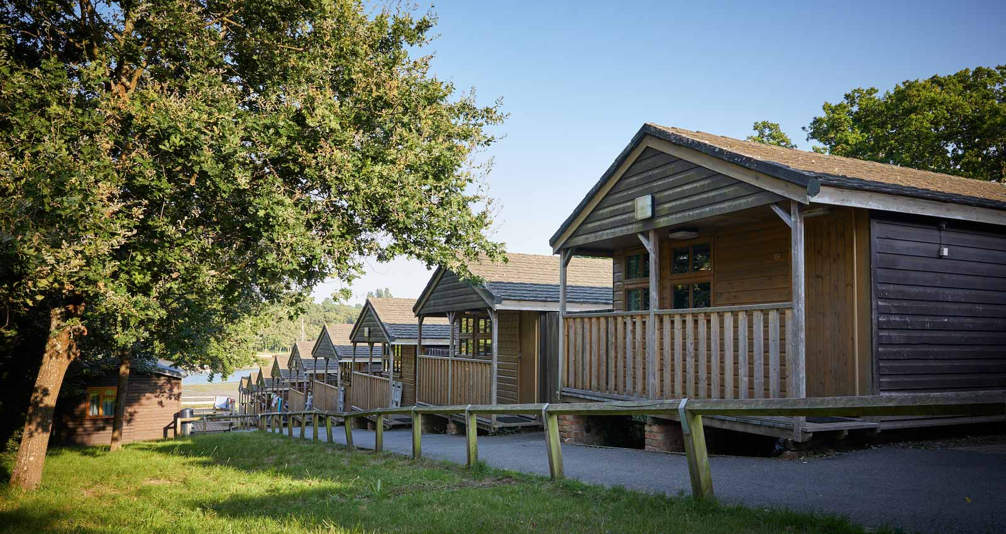
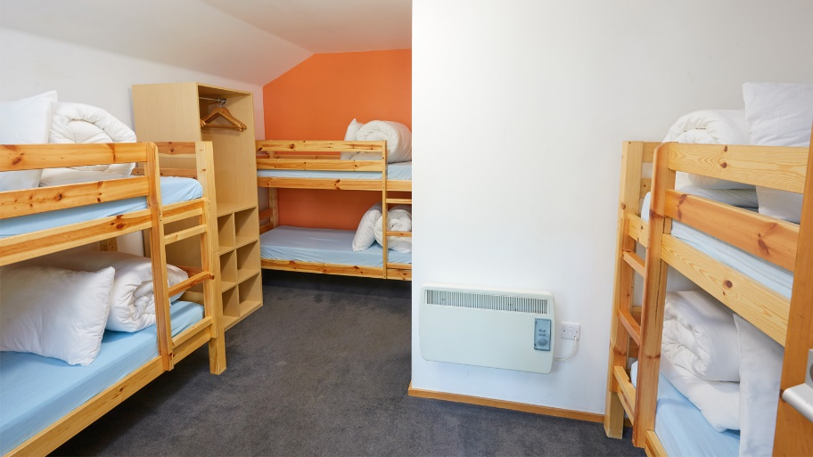
Little Canada
Meet ‘groupies’
Settle into cabins
Tour of the site
Dinner in the dining room
Evening activity
Bedtime
Friday (arrival day)
Notes:
Faded picture background with full-color overlay
(Intermediate)
Tip: For best results with the picture overlay on this slide, use a picture that is the same dimensions as the slide: 7.5” high and 10” wide. If the picture is not the same height and width, resize or crop to those dimensions before following the instructions below.
To reproduce the background effects on this slide, do the following:
On the Home tab, in the Slides group, click Layout, and then click Blank.
Right-click the slide and then click Format Background.
In the Format Background dialog box, click Fill in the left pane. In the Fill pane, select Picture or texture fill, and then under Insert from, click File.
In the Insert Picture dialog box, select a picture, and then click Insert.
Also in the Format Background dialog box, in the Fill pane, in the Transparency box, enter 50%.
Also in the Format Background dialog box, click Picture Color in the left pane. In the Picture Color pane, under Recolor, click the button next to Presets, and then click Tan, Background color 2 Light (third row, first option from the left).
On the Insert tab, in the Images group, click Picture.
In the Insert Picture dialog box, select the same picture chosen for the background, and then click Insert.
Select the picture. Under Picture Tools, on the Format tab, in the bottom right corner of the Size group, click the Size and Position dialog box launcher. In the Format Picture dialog box, resize or crop the image so that the height is set to 7.5” and the width is set to 2.25”.
To crop the picture, click Crop in the left pane, and in the Crop pane, under Crop position, enter values into the Height, Width, Left, and Top boxes.
To resize the picture, click Size in the left pane, and in the Size pane, under Size and rotate, enter values into the Height and Width boxes.
Also in the Format Picture dialog box, click Glow and Soft Edges in the left pane, and then in the Glow and Soft Edges pane, under Soft Edges, in the Size box enter 10 point.

Slide 7
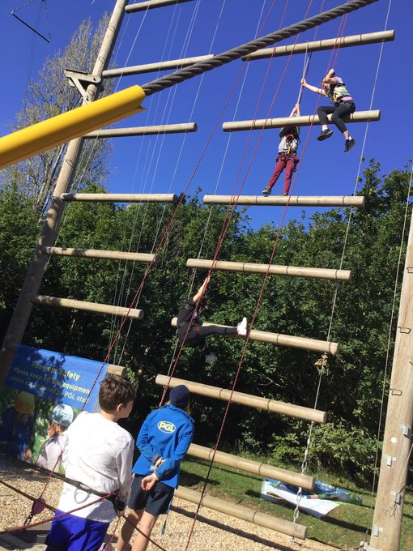




Little Canada
Breakfast
2 x activities
Lunch
2 x activities
Dinner
Free time
Evening activity
Bedtime
Saturday & Sunday
Notes:
Faded picture background with full-color overlay
(Intermediate)
Tip: For best results with the picture overlay on this slide, use a picture that is the same dimensions as the slide: 7.5” high and 10” wide. If the picture is not the same height and width, resize or crop to those dimensions before following the instructions below.
To reproduce the background effects on this slide, do the following:
On the Home tab, in the Slides group, click Layout, and then click Blank.
Right-click the slide and then click Format Background.
In the Format Background dialog box, click Fill in the left pane. In the Fill pane, select Picture or texture fill, and then under Insert from, click File.
In the Insert Picture dialog box, select a picture, and then click Insert.
Also in the Format Background dialog box, in the Fill pane, in the Transparency box, enter 50%.
Also in the Format Background dialog box, click Picture Color in the left pane. In the Picture Color pane, under Recolor, click the button next to Presets, and then click Tan, Background color 2 Light (third row, first option from the left).
On the Insert tab, in the Images group, click Picture.
In the Insert Picture dialog box, select the same picture chosen for the background, and then click Insert.
Select the picture. Under Picture Tools, on the Format tab, in the bottom right corner of the Size group, click the Size and Position dialog box launcher. In the Format Picture dialog box, resize or crop the image so that the height is set to 7.5” and the width is set to 2.25”.
To crop the picture, click Crop in the left pane, and in the Crop pane, under Crop position, enter values into the Height, Width, Left, and Top boxes.
To resize the picture, click Size in the left pane, and in the Size pane, under Size and rotate, enter values into the Height and Width boxes.
Also in the Format Picture dialog box, click Glow and Soft Edges in the left pane, and then in the Glow and Soft Edges pane, under Soft Edges, in the Size box enter 10 point.

Slide 8


Little Canada
Breakfast
Packing cases
2 x activities
Lunch
Depart PGL
Arrive at school (usually around 4pm)
Monday (departure day)
Notes:
Faded picture background with full-color overlay
(Intermediate)
Tip: For best results with the picture overlay on this slide, use a picture that is the same dimensions as the slide: 7.5” high and 10” wide. If the picture is not the same height and width, resize or crop to those dimensions before following the instructions below.
To reproduce the background effects on this slide, do the following:
On the Home tab, in the Slides group, click Layout, and then click Blank.
Right-click the slide and then click Format Background.
In the Format Background dialog box, click Fill in the left pane. In the Fill pane, select Picture or texture fill, and then under Insert from, click File.
In the Insert Picture dialog box, select a picture, and then click Insert.
Also in the Format Background dialog box, in the Fill pane, in the Transparency box, enter 50%.
Also in the Format Background dialog box, click Picture Color in the left pane. In the Picture Color pane, under Recolor, click the button next to Presets, and then click Tan, Background color 2 Light (third row, first option from the left).
On the Insert tab, in the Images group, click Picture.
In the Insert Picture dialog box, select the same picture chosen for the background, and then click Insert.
Select the picture. Under Picture Tools, on the Format tab, in the bottom right corner of the Size group, click the Size and Position dialog box launcher. In the Format Picture dialog box, resize or crop the image so that the height is set to 7.5” and the width is set to 2.25”.
To crop the picture, click Crop in the left pane, and in the Crop pane, under Crop position, enter values into the Height, Width, Left, and Top boxes.
To resize the picture, click Size in the left pane, and in the Size pane, under Size and rotate, enter values into the Height and Width boxes.
Also in the Format Picture dialog box, click Glow and Soft Edges in the left pane, and then in the Glow and Soft Edges pane, under Soft Edges, in the Size box enter 10 point.

Slide 9



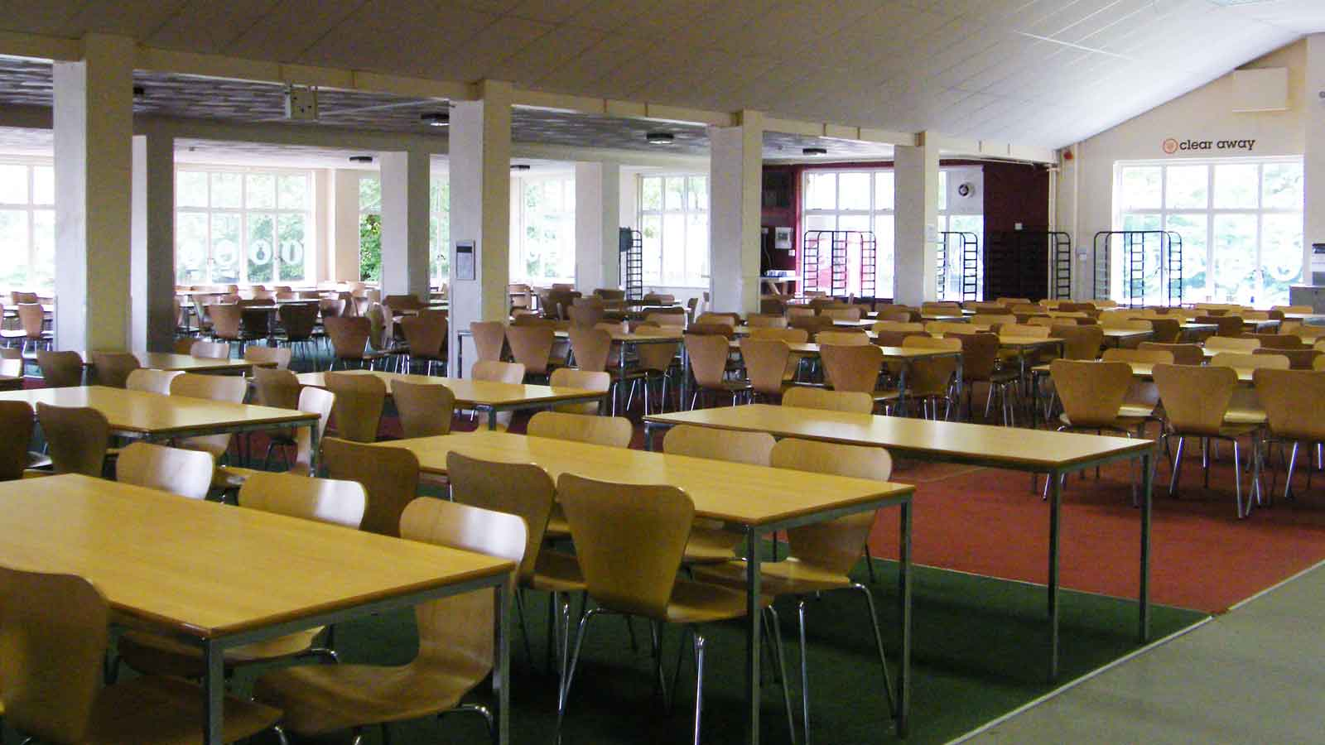
Dining Hall
Notes:
Faded picture background with full-color overlay
(Intermediate)
Tip: For best results with the picture overlay on this slide, use a picture that is the same dimensions as the slide: 7.5” high and 10” wide. If the picture is not the same height and width, resize or crop to those dimensions before following the instructions below.
To reproduce the background effects on this slide, do the following:
On the Home tab, in the Slides group, click Layout, and then click Blank.
Right-click the slide and then click Format Background.
In the Format Background dialog box, click Fill in the left pane. In the Fill pane, select Picture or texture fill, and then under Insert from, click File.
In the Insert Picture dialog box, select a picture, and then click Insert.
Also in the Format Background dialog box, in the Fill pane, in the Transparency box, enter 50%.
Also in the Format Background dialog box, click Picture Color in the left pane. In the Picture Color pane, under Recolor, click the button next to Presets, and then click Tan, Background color 2 Light (third row, first option from the left).
On the Insert tab, in the Images group, click Picture.
In the Insert Picture dialog box, select the same picture chosen for the background, and then click Insert.
Select the picture. Under Picture Tools, on the Format tab, in the bottom right corner of the Size group, click the Size and Position dialog box launcher. In the Format Picture dialog box, resize or crop the image so that the height is set to 7.5” and the width is set to 2.25”.
To crop the picture, click Crop in the left pane, and in the Crop pane, under Crop position, enter values into the Height, Width, Left, and Top boxes.
To resize the picture, click Size in the left pane, and in the Size pane, under Size and rotate, enter values into the Height and Width boxes.
Also in the Format Picture dialog box, click Glow and Soft Edges in the left pane, and then in the Glow and Soft Edges pane, under Soft Edges, in the Size box enter 10 point.

Slide 10

Menu
Notes:
Faded picture background with full-color overlay
(Intermediate)
Tip: For best results with the picture overlay on this slide, use a picture that is the same dimensions as the slide: 7.5” high and 10” wide. If the picture is not the same height and width, resize or crop to those dimensions before following the instructions below.
To reproduce the background effects on this slide, do the following:
On the Home tab, in the Slides group, click Layout, and then click Blank.
Right-click the slide and then click Format Background.
In the Format Background dialog box, click Fill in the left pane. In the Fill pane, select Picture or texture fill, and then under Insert from, click File.
In the Insert Picture dialog box, select a picture, and then click Insert.
Also in the Format Background dialog box, in the Fill pane, in the Transparency box, enter 50%.
Also in the Format Background dialog box, click Picture Color in the left pane. In the Picture Color pane, under Recolor, click the button next to Presets, and then click Tan, Background color 2 Light (third row, first option from the left).
On the Insert tab, in the Images group, click Picture.
In the Insert Picture dialog box, select the same picture chosen for the background, and then click Insert.
Select the picture. Under Picture Tools, on the Format tab, in the bottom right corner of the Size group, click the Size and Position dialog box launcher. In the Format Picture dialog box, resize or crop the image so that the height is set to 7.5” and the width is set to 2.25”.
To crop the picture, click Crop in the left pane, and in the Crop pane, under Crop position, enter values into the Height, Width, Left, and Top boxes.
To resize the picture, click Size in the left pane, and in the Size pane, under Size and rotate, enter values into the Height and Width boxes.
Also in the Format Picture dialog box, click Glow and Soft Edges in the left pane, and then in the Glow and Soft Edges pane, under Soft Edges, in the Size box enter 10 point.

Slide 11


Other
Contact
Social media updates
Devices
Shop
  -£20 pocket money limit
Kit list
Other schools
Notes:
Faded picture background with full-color overlay
(Intermediate)
Tip: For best results with the picture overlay on this slide, use a picture that is the same dimensions as the slide: 7.5” high and 10” wide. If the picture is not the same height and width, resize or crop to those dimensions before following the instructions below.
To reproduce the background effects on this slide, do the following:
On the Home tab, in the Slides group, click Layout, and then click Blank.
Right-click the slide and then click Format Background.
In the Format Background dialog box, click Fill in the left pane. In the Fill pane, select Picture or texture fill, and then under Insert from, click File.
In the Insert Picture dialog box, select a picture, and then click Insert.
Also in the Format Background dialog box, in the Fill pane, in the Transparency box, enter 50%.
Also in the Format Background dialog box, click Picture Color in the left pane. In the Picture Color pane, under Recolor, click the button next to Presets, and then click Tan, Background color 2 Light (third row, first option from the left).
On the Insert tab, in the Images group, click Picture.
In the Insert Picture dialog box, select the same picture chosen for the background, and then click Insert.
Select the picture. Under Picture Tools, on the Format tab, in the bottom right corner of the Size group, click the Size and Position dialog box launcher. In the Format Picture dialog box, resize or crop the image so that the height is set to 7.5” and the width is set to 2.25”.
To crop the picture, click Crop in the left pane, and in the Crop pane, under Crop position, enter values into the Height, Width, Left, and Top boxes.
To resize the picture, click Size in the left pane, and in the Size pane, under Size and rotate, enter values into the Height and Width boxes.
Also in the Format Picture dialog box, click Glow and Soft Edges in the left pane, and then in the Glow and Soft Edges pane, under Soft Edges, in the Size box enter 10 point.

Slide 12
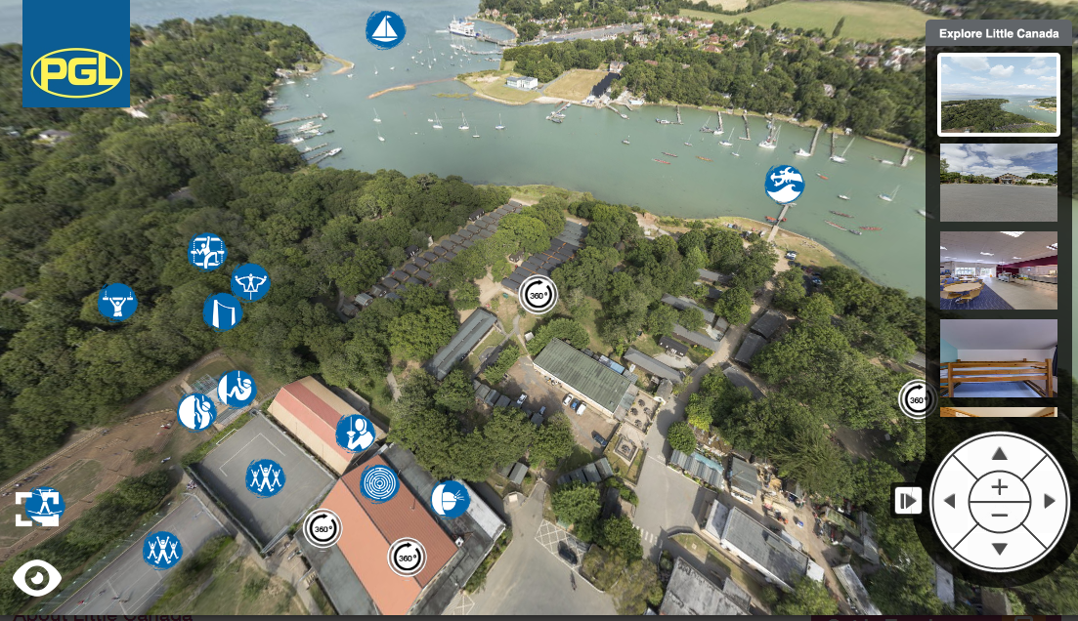
More information
Osborne House
https://www.english-heritage.org.uk/visit/places/osborne/
PGL Little Canada
https://www.pgl.co.uk/en-gb/school-trips/primary-schools/centres/little-canada
Notes:
Faded picture background with full-color overlay
(Intermediate)
Tip: For best results with the picture overlay on this slide, use a picture that is the same dimensions as the slide: 7.5” high and 10” wide. If the picture is not the same height and width, resize or crop to those dimensions before following the instructions below.
To reproduce the background effects on this slide, do the following:
On the Home tab, in the Slides group, click Layout, and then click Blank.
Right-click the slide and then click Format Background.
In the Format Background dialog box, click Fill in the left pane. In the Fill pane, select Picture or texture fill, and then under Insert from, click File.
In the Insert Picture dialog box, select a picture, and then click Insert.
Also in the Format Background dialog box, in the Fill pane, in the Transparency box, enter 50%.
Also in the Format Background dialog box, click Picture Color in the left pane. In the Picture Color pane, under Recolor, click the button next to Presets, and then click Tan, Background color 2 Light (third row, first option from the left).
On the Insert tab, in the Images group, click Picture.
In the Insert Picture dialog box, select the same picture chosen for the background, and then click Insert.
Select the picture. Under Picture Tools, on the Format tab, in the bottom right corner of the Size group, click the Size and Position dialog box launcher. In the Format Picture dialog box, resize or crop the image so that the height is set to 7.5” and the width is set to 2.25”.
To crop the picture, click Crop in the left pane, and in the Crop pane, under Crop position, enter values into the Height, Width, Left, and Top boxes.
To resize the picture, click Size in the left pane, and in the Size pane, under Size and rotate, enter values into the Height and Width boxes.
Also in the Format Picture dialog box, click Glow and Soft Edges in the left pane, and then in the Glow and Soft Edges pane, under Soft Edges, in the Size box enter 10 point.

