Slide 1
Whole School Assembly

Slide 2


Slide 3
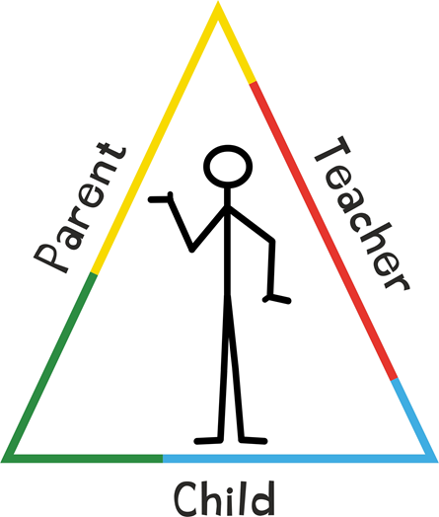
Building Happy Life Habits
Trick Box – 24 tricks introduced
First 15 tricks will be introduced this year
Each trick will help us all develop positive skills and habits to help us be the best that we can be

Slide 4
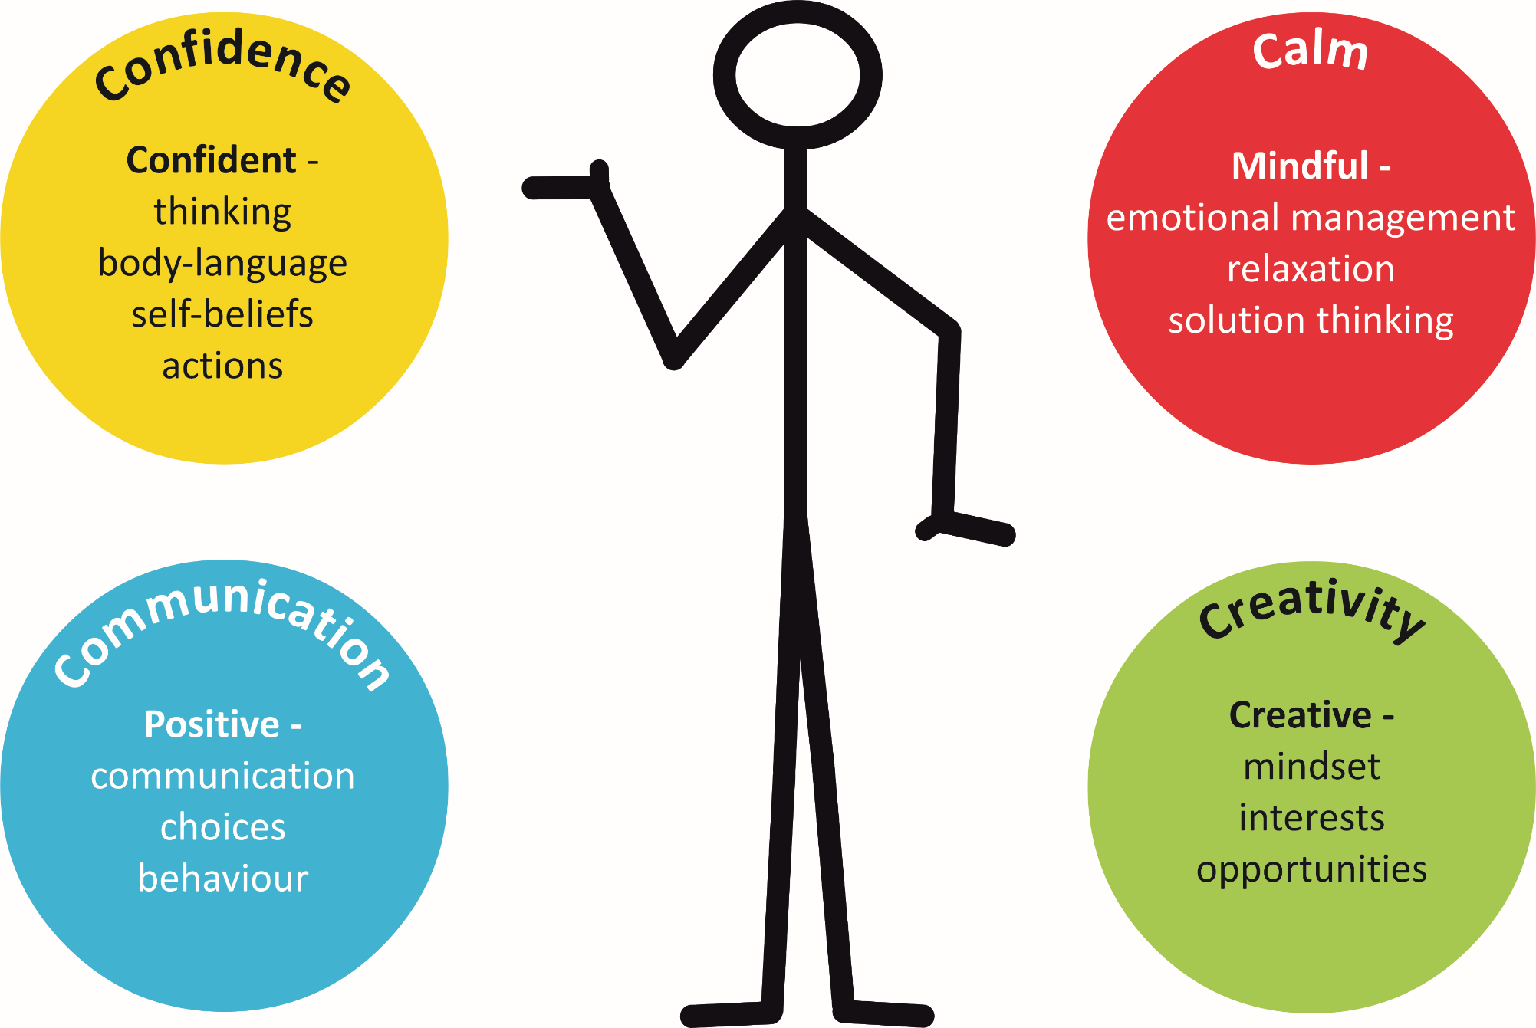
Trick Box programmes develop personal skills in 4 key areas through positive habit formation.

Slide 5

Trick Box outcomes are built around the happy life habits we all need to thrive.
Confidence
I say positive things to myself
I am confident in my mind and body
I have a strong inner voice
I stretch my comfort zones
I create confident feelings
Calm
I calm myself down
I relax my whole body
I find solutions
I find a sunny side
I choose my state
Communication
I negotiate confidently
I make positive choices
I set boundaries
I say ‘yes’ to new opportunities
I create different results
Creativity
I do new things
I have creative ideas
I push through limiting beliefs
I plan steps towards my goals
I self-praise

Slide 6
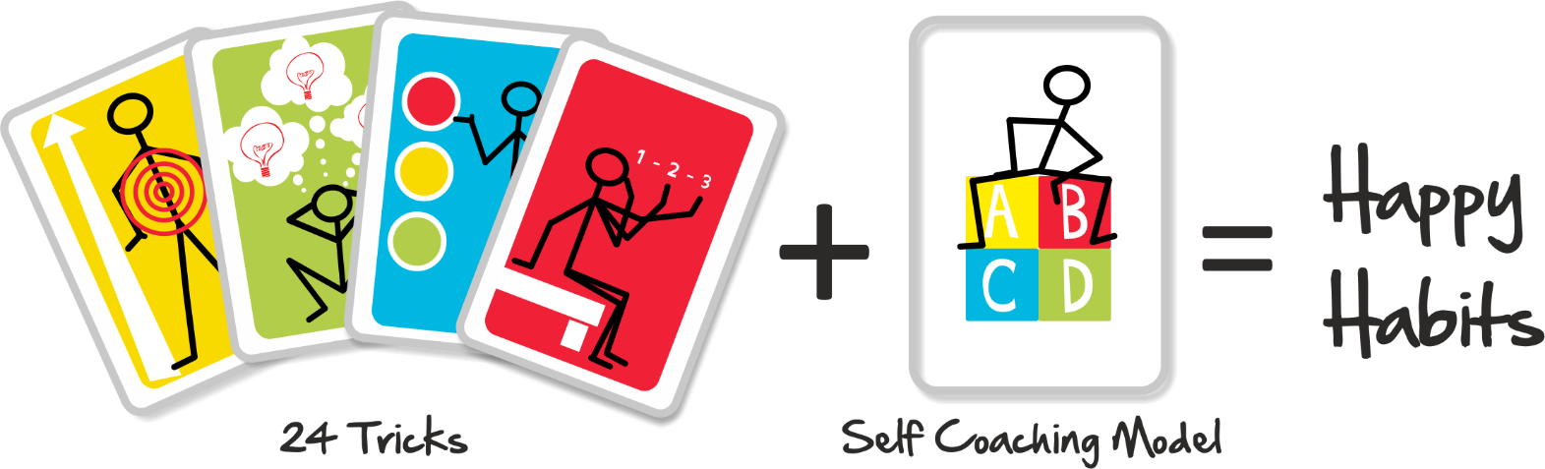
Trick Box will help you talk about your emotions and develop the skills to deal with daily challenges.
By using the tricks you will develop skills to help you manage everyday life.
Your teachers will use the tricks in class and your parents can also practise using the tricks with you at home.

Slide 7
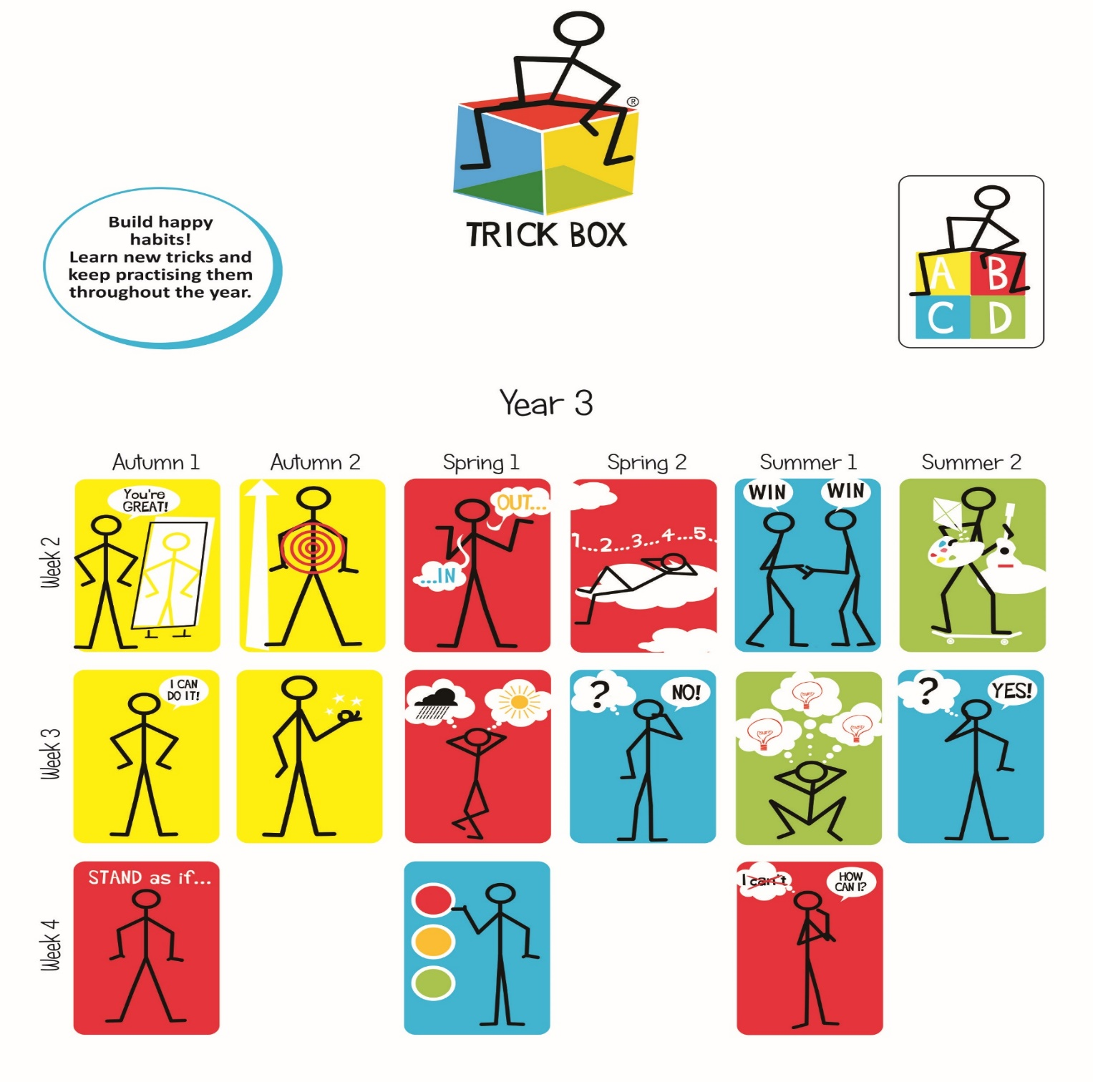

Slide 8
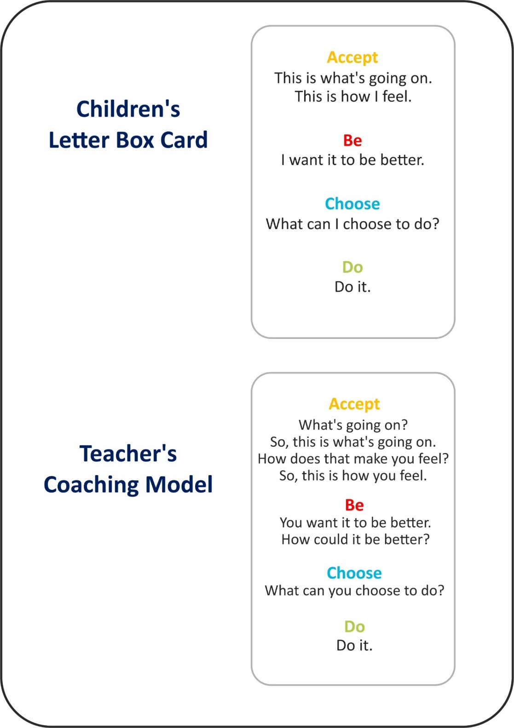
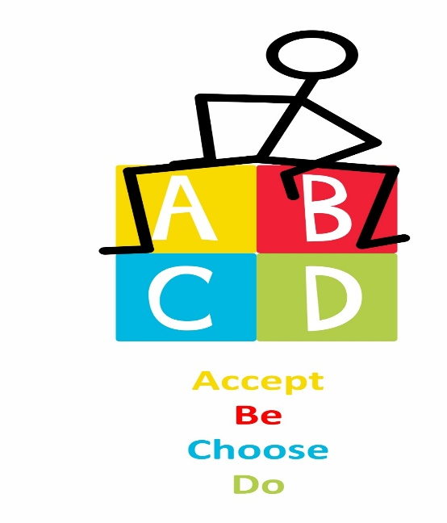
A B C D
Your teachers will use the ABCD approach to help you choose tricks alongside other strategies from school or at home to help them towards positive action.

Slide 9
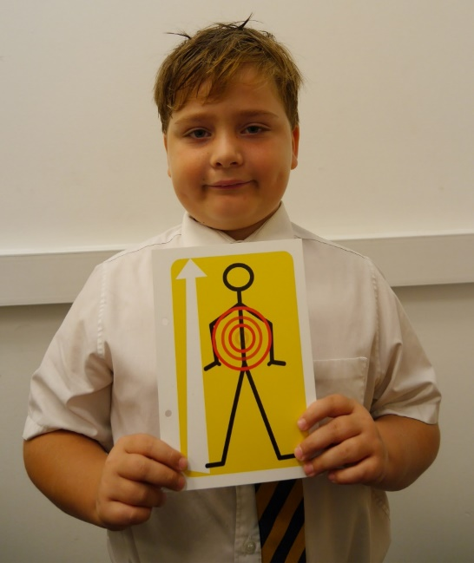
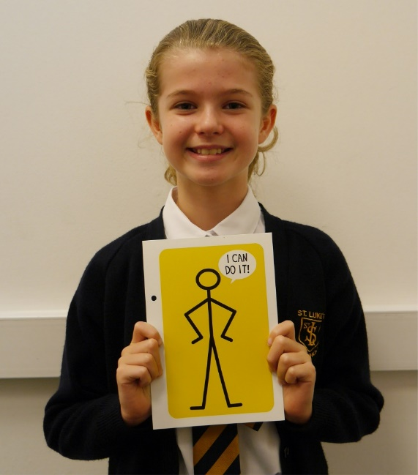
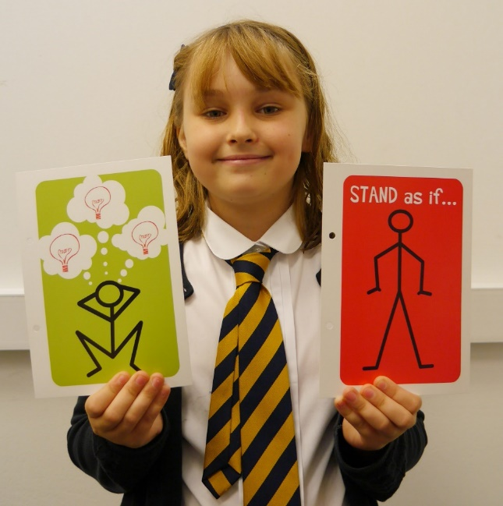
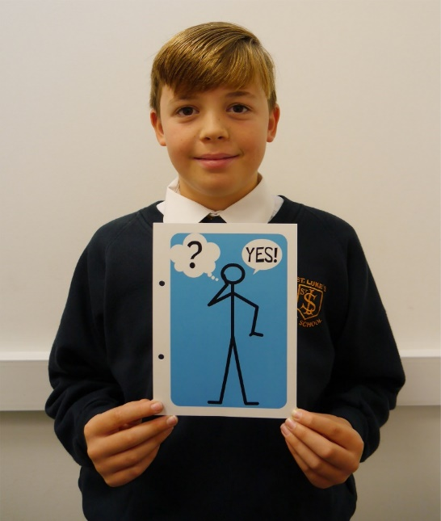

“The ‘Big Voice’ trick gives me confidence to know ‘I can do it’ when I’m singing in the choir.”
Sophie Year 5
Everyone has their favourite trick
“I use the ‘Stand Tall’ trick to help me do difficult things.”
Edward Year 4
“The ‘Light Bulb’ trick helps me to think of the answers not the problem and the ‘Stand as If’ trick helps me to face my fears.”
Rebecca Year 4
“The ‘Big Yes’ trick helps me to do new things. It gives me confidence to have a go.”
Fin year 6

Slide 10
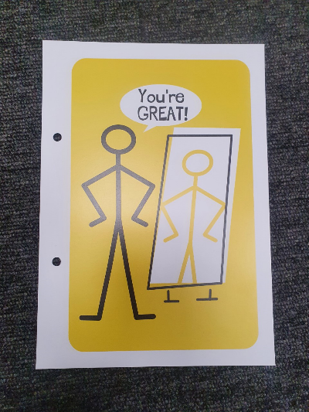
Mirror Mirror
The first Trick: Mirror Mirror
Identify positive ‘self-talk’
Important to be a good friend to ourselves and say nice things to ourselves in our head
Get used to saying good things to ourselves and be on our own side- ‘Well done’, ‘You can do it’ ‘You’re doing your best’
When we need a boost or finding something difficult or someone is being unkind – have a kind voice in our own head
Notes:
Positive self-talk is an inner monologue that makes you feel good about yourself and everything going on in your life. It's an optimistic voice in your head that encourages you to look at the bright side, pick yourself up when you fall and recognize when you fail.

