Slide 1


Getting to know your Danger Brain

Slide 2
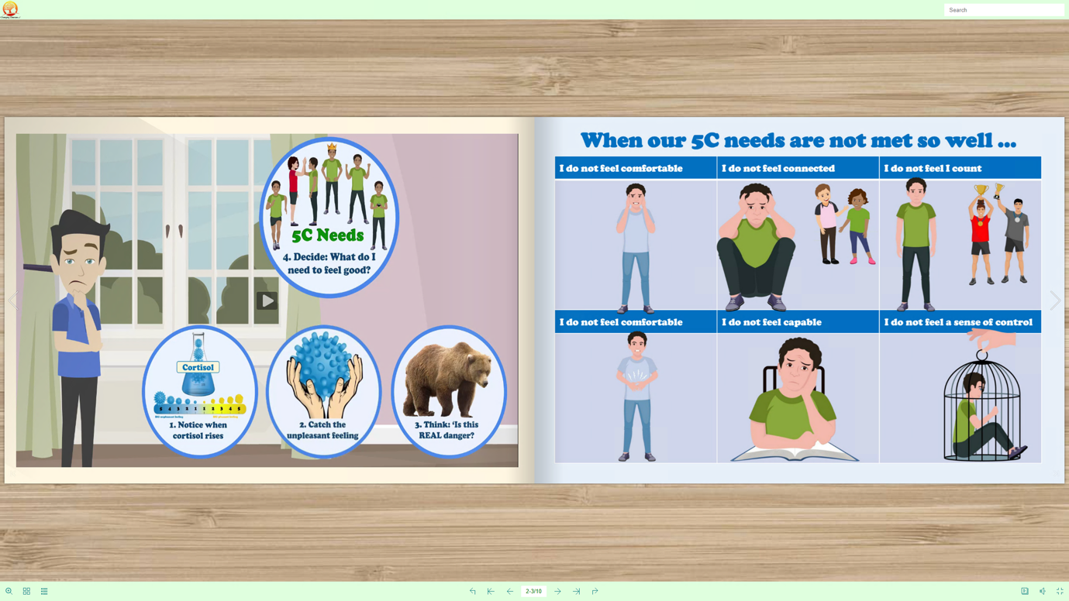
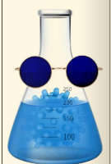
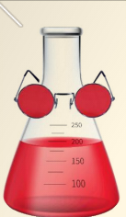

Slide 3
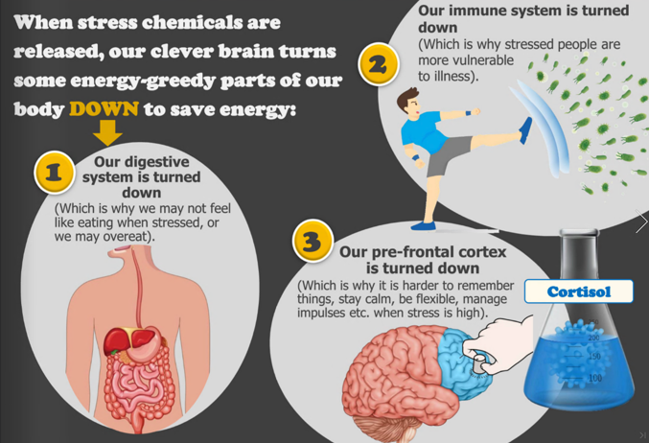

Slide 4
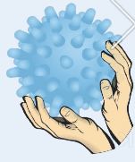
GOALS: To be ‘Prickle Curious'- and look behind the unpleasant feeling for the unmet need To get really good at working out what the stressor – the unmet need- behind the prickle

Slide 5
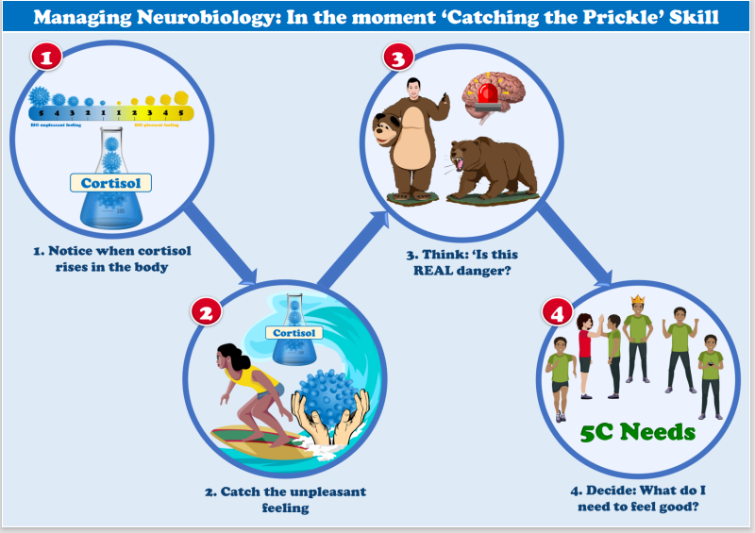

Slide 6
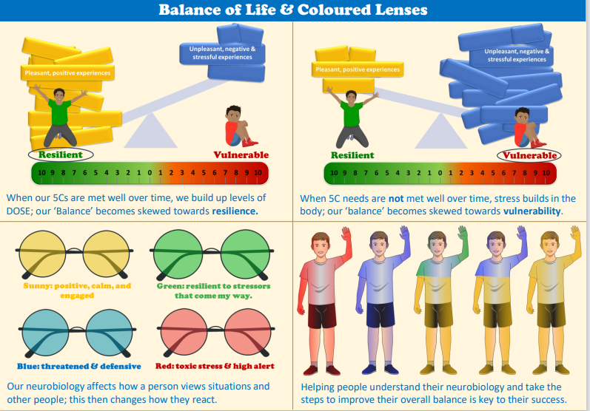

Slide 7
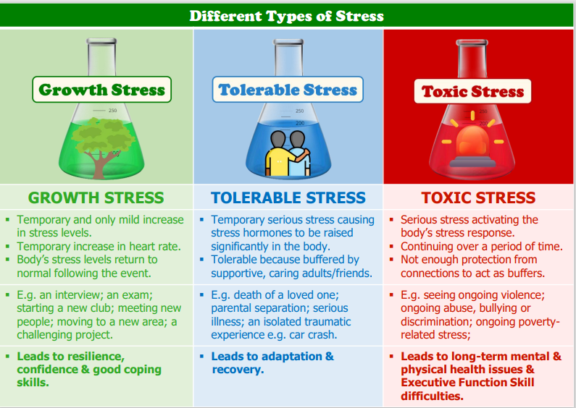

Slide 9
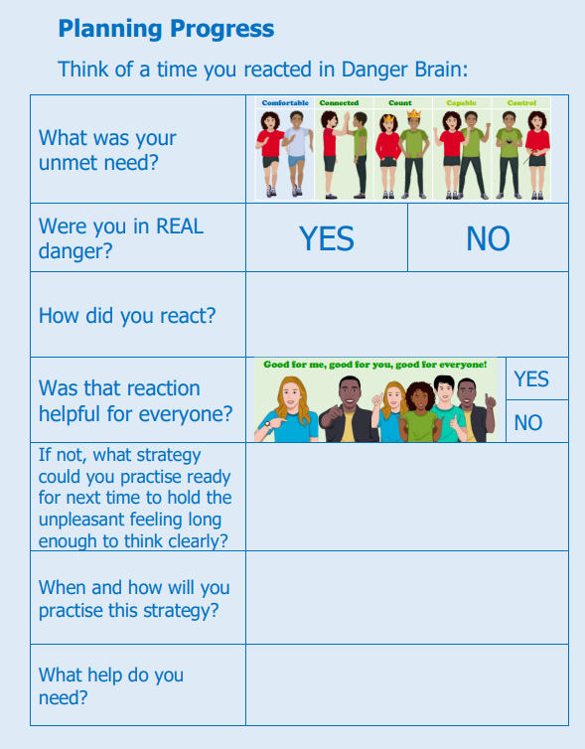

Slide 10
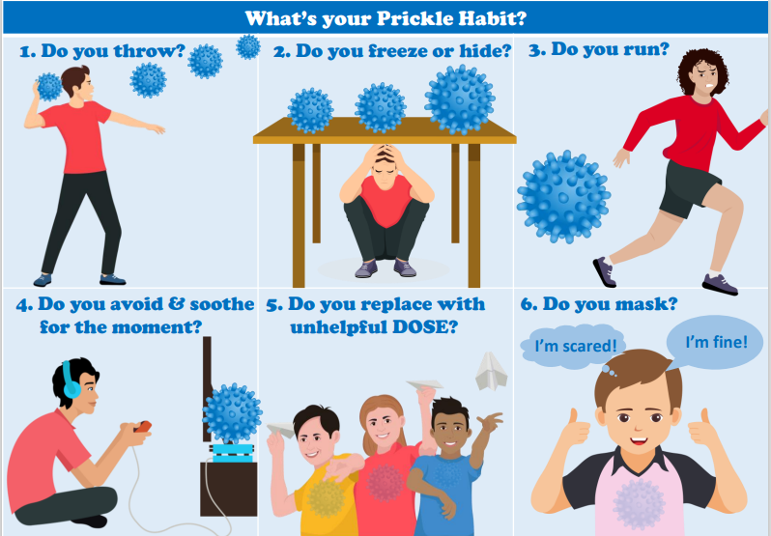

Slide 11


