Slide 1
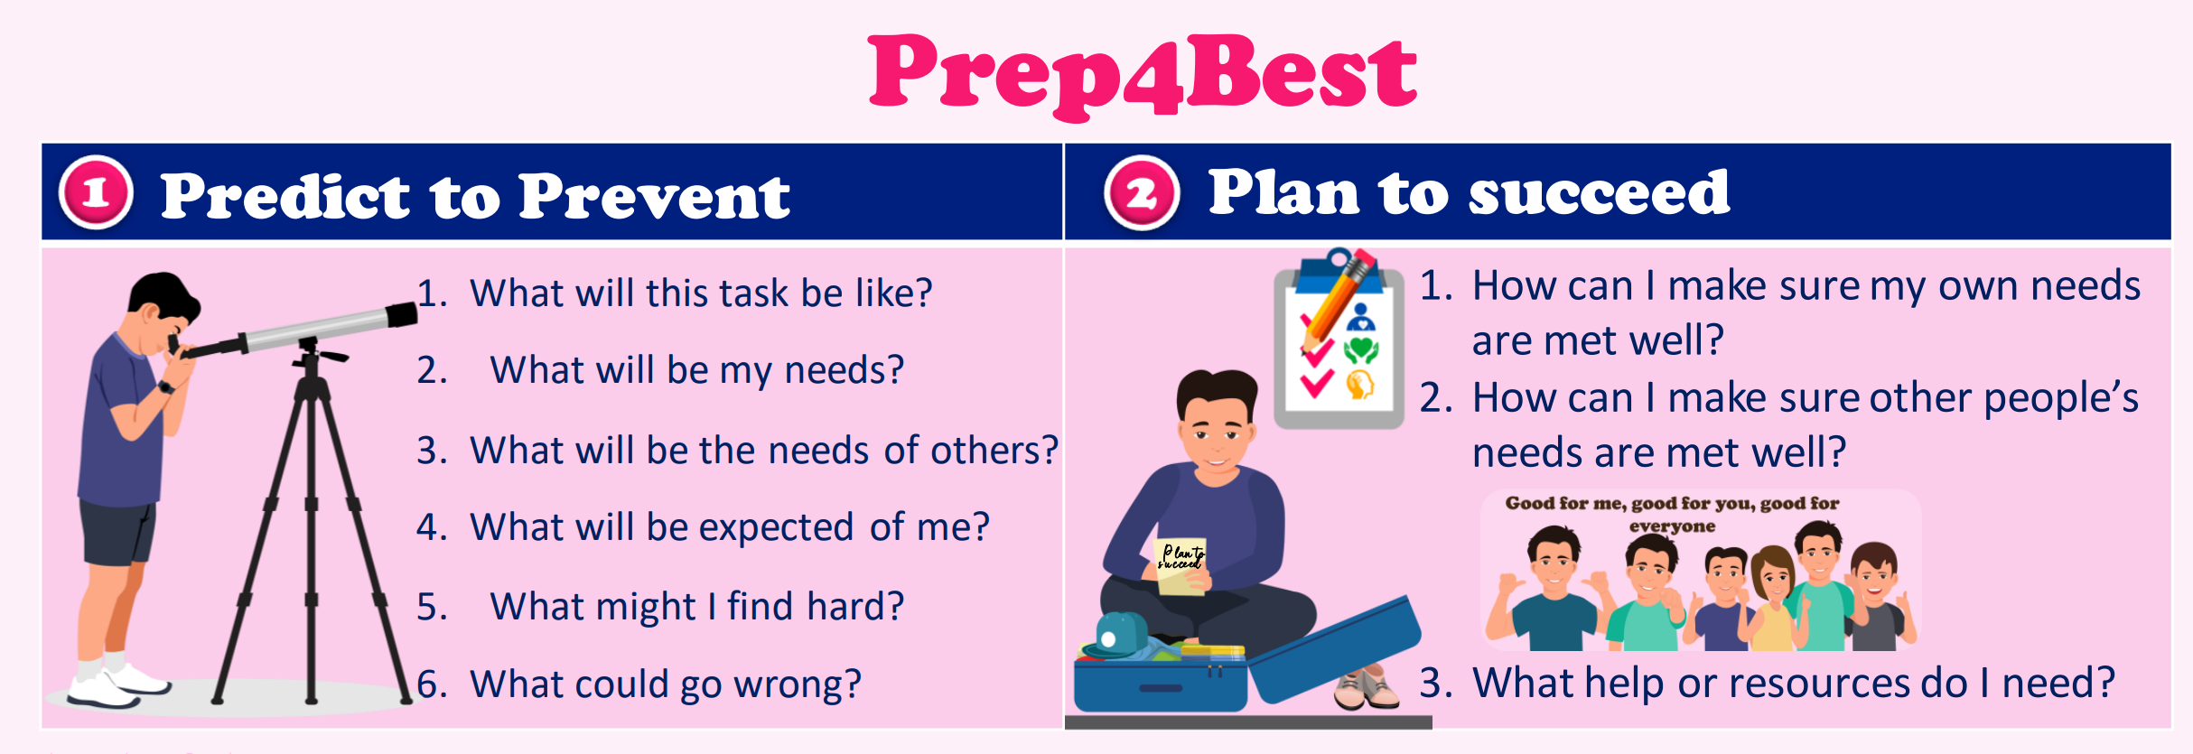

Prep4Best
Getting Brain Ready

Slide 3
Predict to Prevent
Plan to Succeed

Slide 4
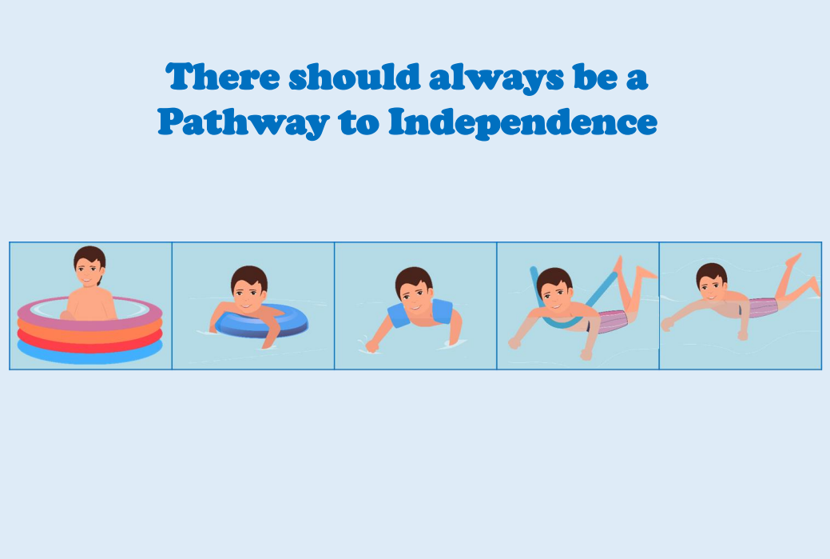
Predict to Prevent
Plan to Succeed

Slide 5
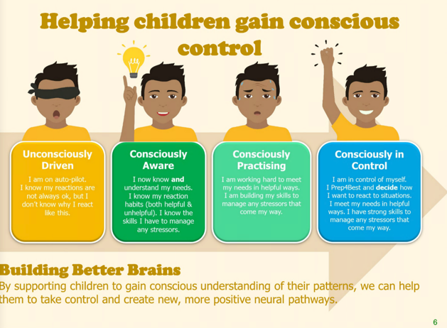

Slide 6
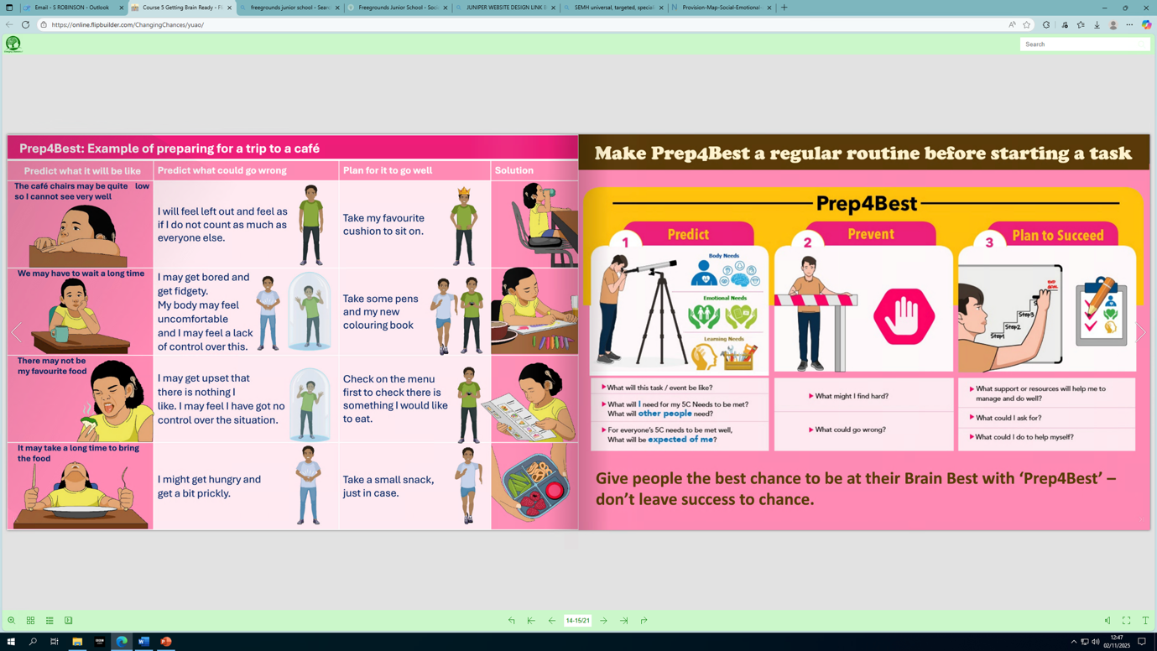

Slide 7
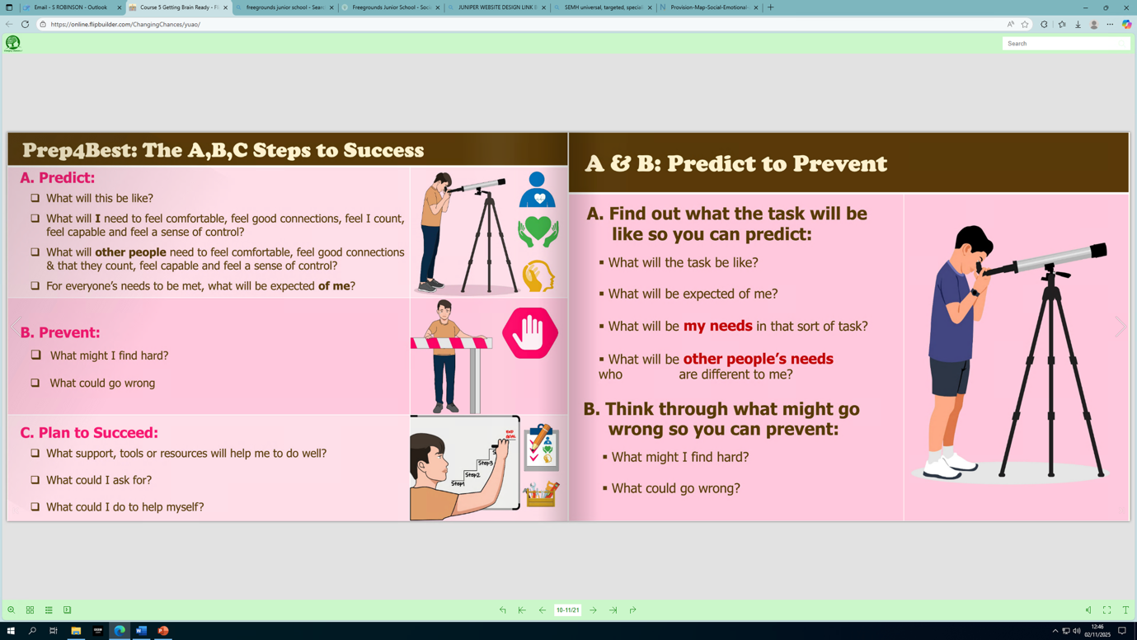

Slide 8
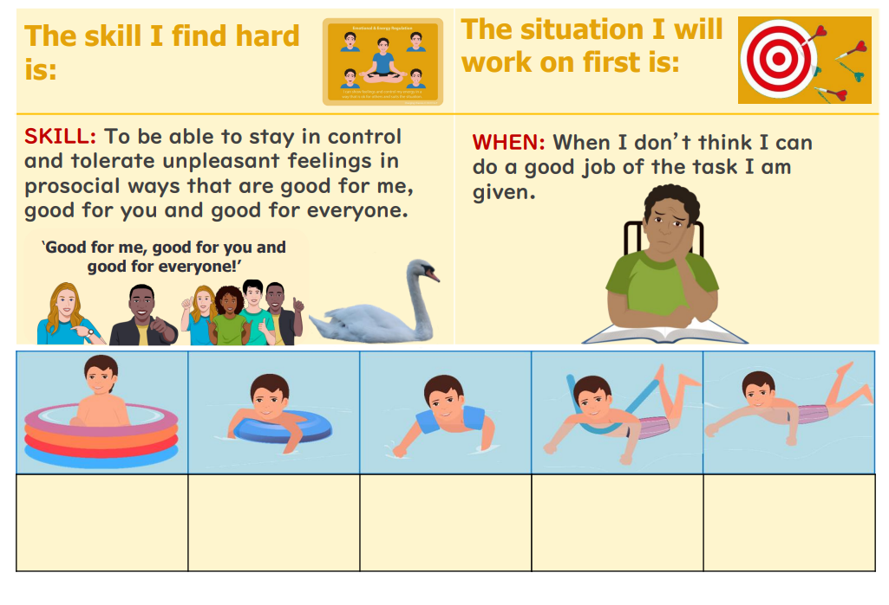
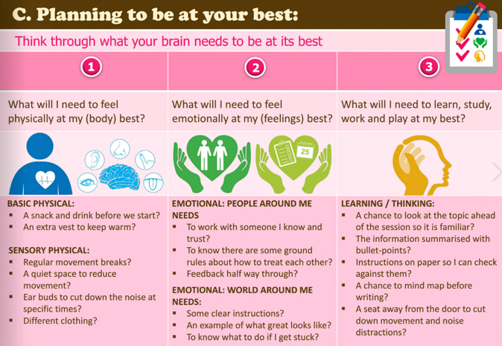

Slide 9
Do you want it to stay the same or would you like it to be different?

