Slide 1

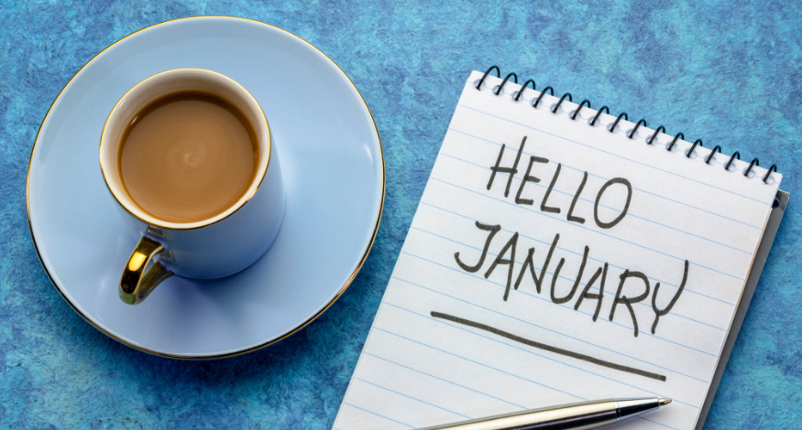
Parent Coffee Morning 2026
Coffee & Connection: Good Starts

Slide 2
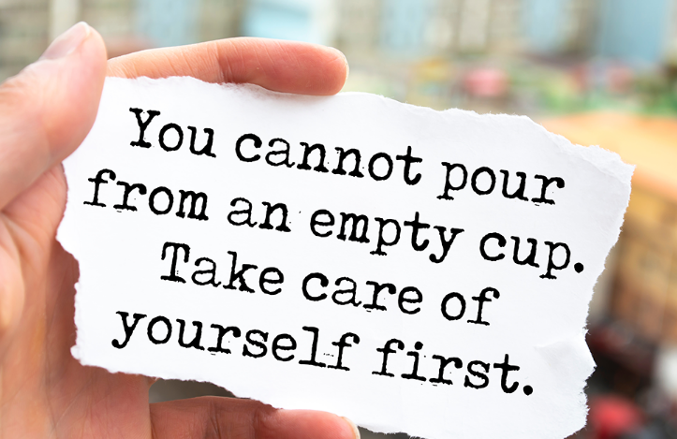
Strong Start to 2026!
January can feel tough!
Resilience to push through dark, cold mornings.
Important to look after ourselves – connect with others.
Feel-good chemicals (Daily DOSE)
Support our children to feel gratitude and build resilience

Slide 3
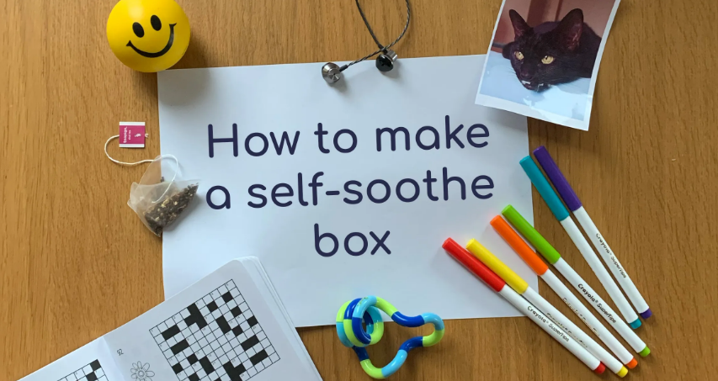
Strong Start to 2026!
Session Presentation:
Empowerment Approach – how we use this in school to teach children to be at their Brain Best.
How we can support children to build resilience and understand their 5C Needs.
Create a ‘Soothe Box’ with your child to support them to feel calm.

Slide 4
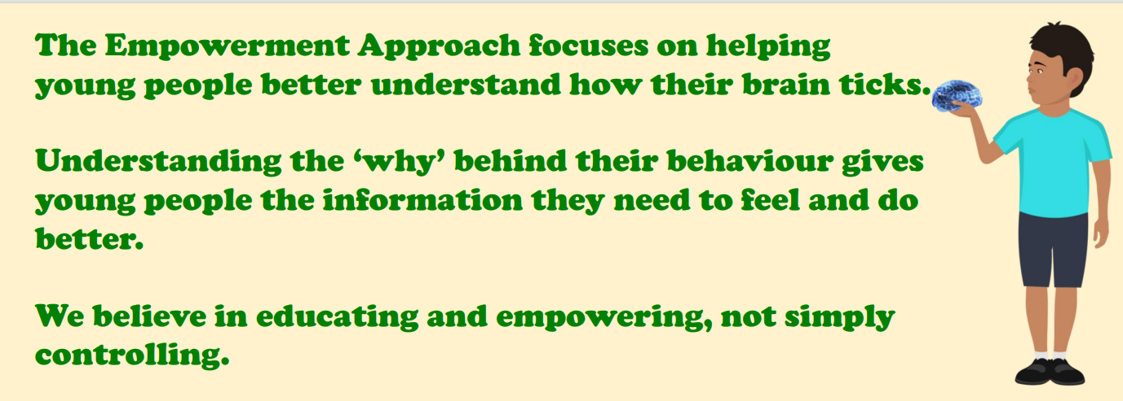
Empowering our Children
Teaching your child to be at their Brain Best!
Be Curious not Furious!

Slide 5
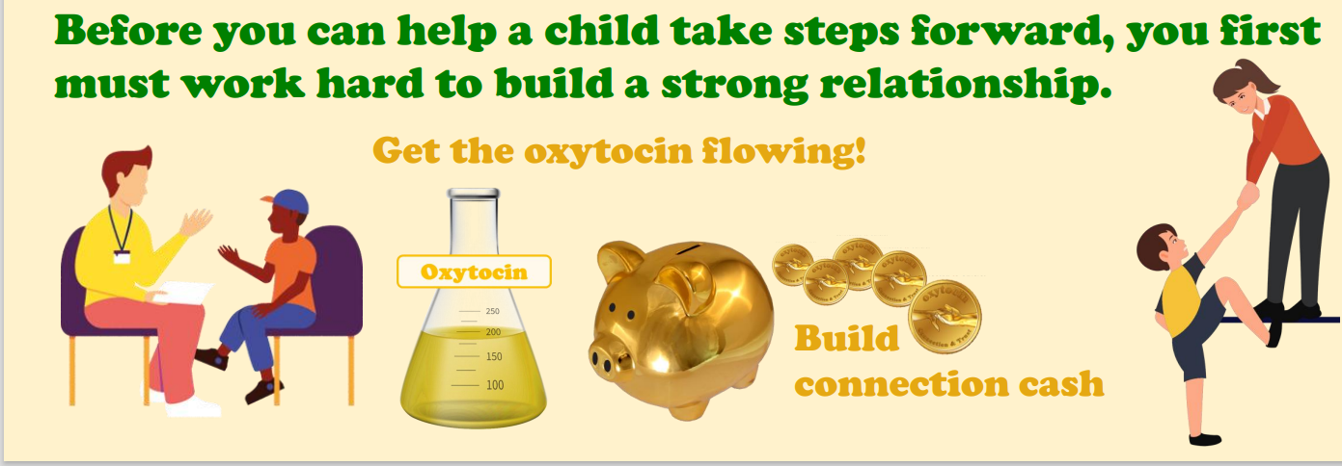
5C Needs / Daily DOSE

Slide 6
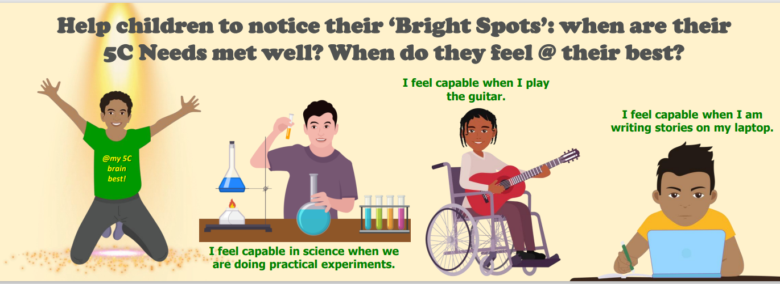
Bright Spots

Slide 7
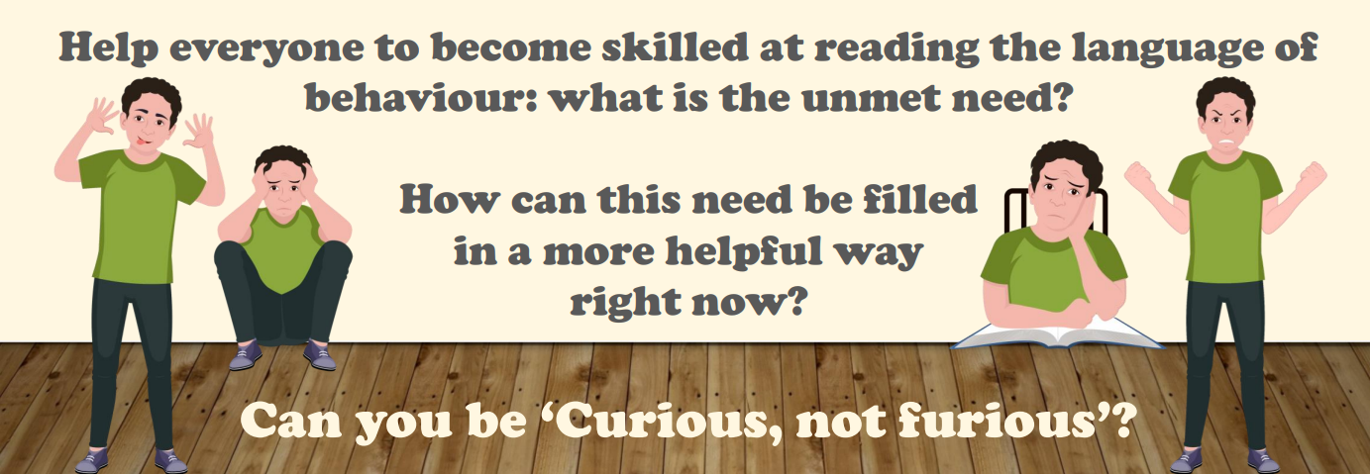
Understanding our Brains

Slide 8
Balance of Life:
What makes a difference to how our brain builds and develops through childhood?
https://www.youtube.com/watch?v=hMyDFYSkZSU

Slide 9
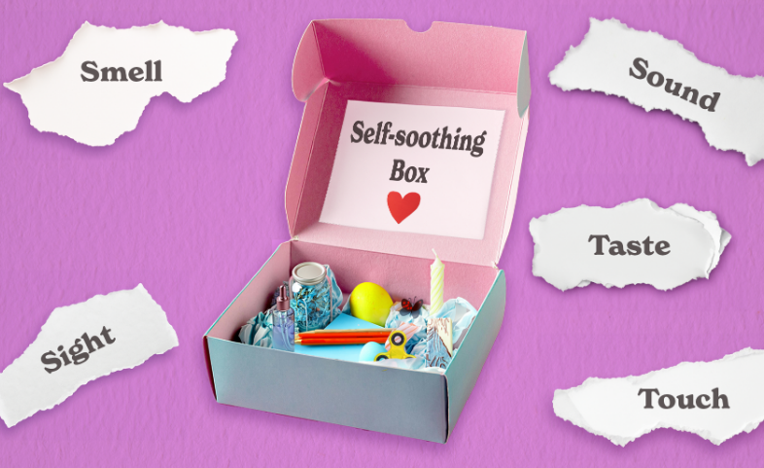
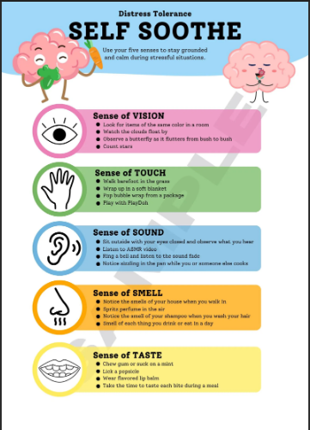
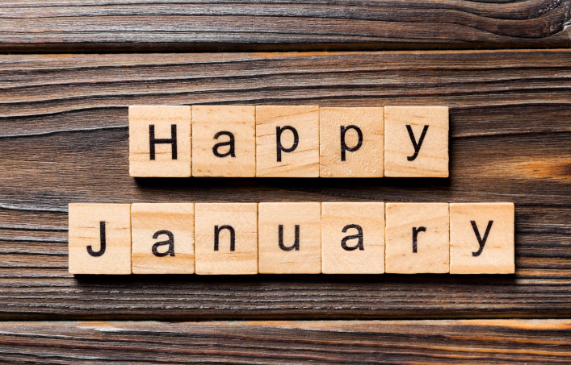
Creating a Soothe Box
Make a start in school and add to your box at home…
Helping ourselves feel Calm and Resilient…

